Slide 1



Marking and Feedback
with Gemini
Notes:
Thanks _______, and thanks for having me. As mentioned, I’m really excited about the prospect of AI for reducing the administrative burden on teachers and improving outcomes for students.
Today, I’ll be showing you what it looks like to use AI for marking and feedback. I’ve deliberately narrowed the scope to make it as practical as possible and give you a launch point to try it in your own contexts. Let’s start with a really quick demo so that you can see the end goal.

Slide 2
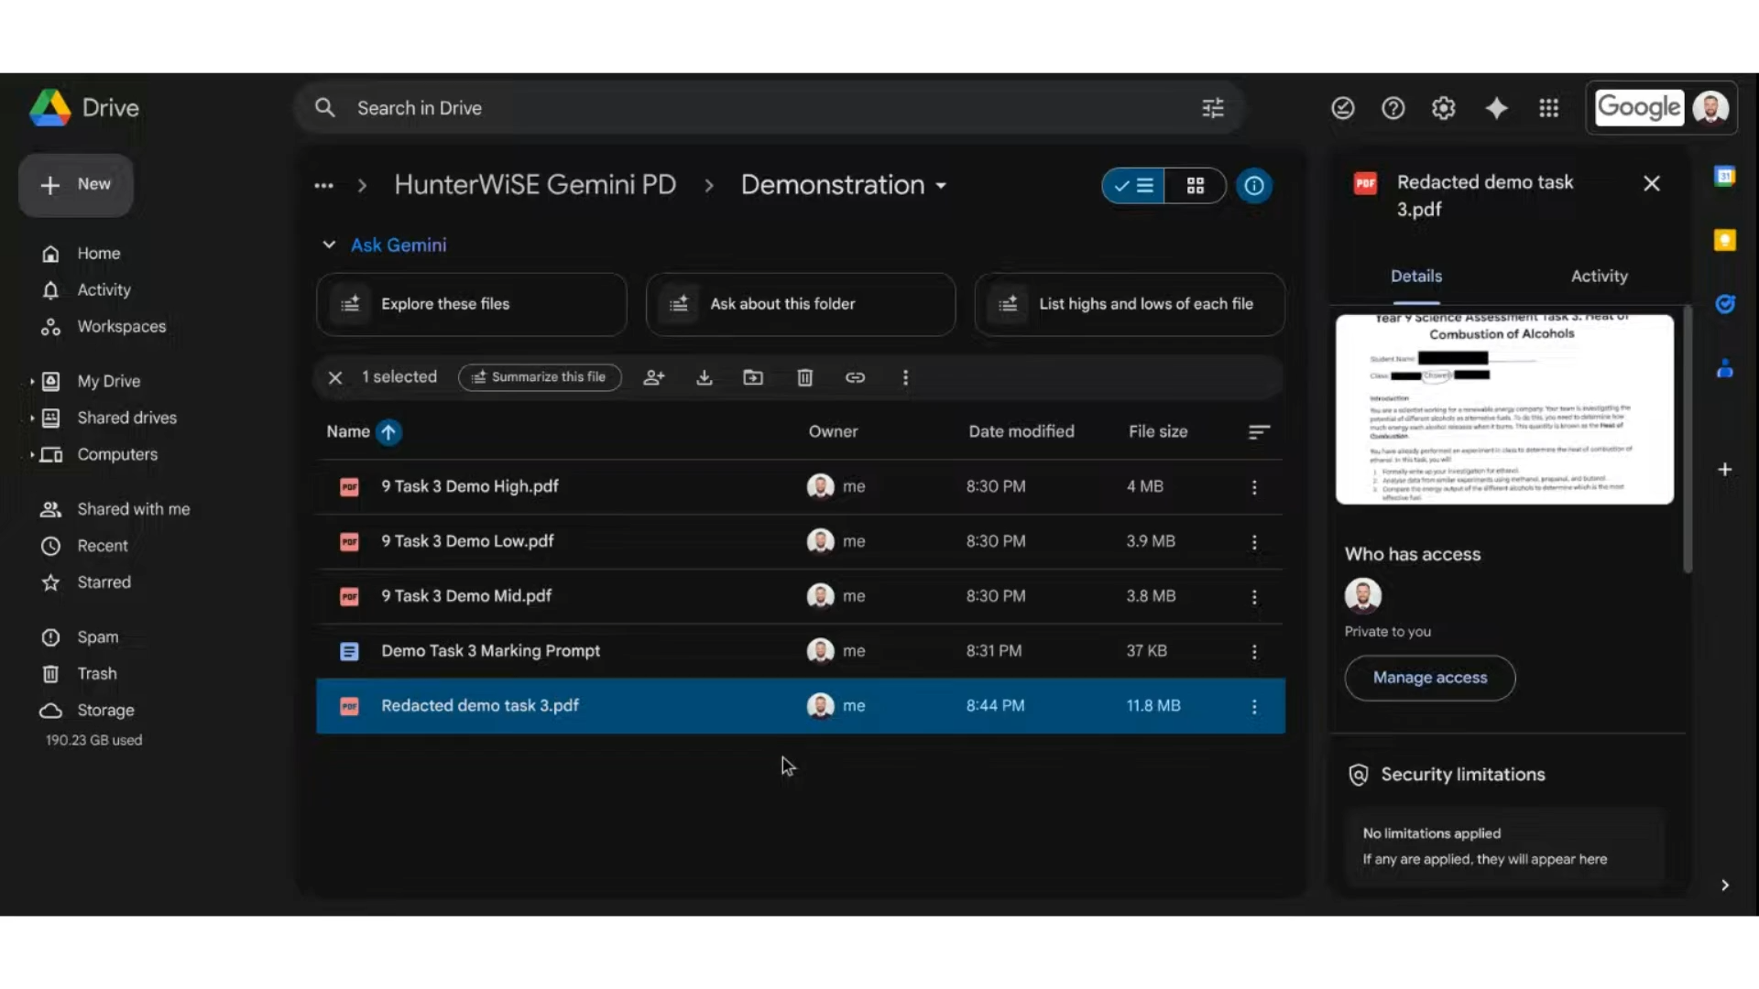

Slide 3

Common Objections
Will I still know where my students are up to in their learning?
What about student privacy?
Notes:
Common objections (2 mins)
Now, as that played I know there’d be a mixed reaction around the room. I’m sure some see it and go- amazing! Others may be a little apprehensive and with good reason. I think there’s a few key objections to using AI for marking and I want to deal with them up front:
How will I know where my students are up to in their learning?
This is probably the strongest objection to AI marking and I think it boils down to the teacher doing it. Marking with AI needs to have human eyes checking and adjusting for every single student. The language we use at my school is “co-marking” because it’s not just feeding them through a machine and getting an output- it involves going through and measuring the mark and feedback with each question to be sure. This takes time and it means you get a sense of where each student has performed. I’ll also show you how you can also use AI to improve teacher reflection so that assessment feeds forward to inform teaching practice.
What about student privacy?
Valid question- you need to be careful if you’re not using a private version of AI. When I started experimenting with the basic models, I would deidentify student work by replacing names with my own student numbering system. If your school has NSW educhat or Google Gemini for enterprise, then your data should be safe.

Slide 4

Benefits of using AI for
Marking and Feedback
Detailed feedback
Saves some time
More consistent
Helps teacher reflection
Notes:
Benefits (2 mins)
Number 1 reason: more detailed and timely feedback helps students learn- the amount of specific and actionable feedback students receive is far greater than if we were manually marking and annotating a task by hand. This is the main reason I’ve stuck with it.
Some time saving- It might take about 2 hours for a marking prompt to be set up, then say 1 hour to feed through 80 tasks for a year group. Formatting and double checking still takes about 3 hours per class. You can see the time saving improves with larger tasks, larger cohorts or repetition year to year. That initial setup investment of time gets quicker each task.
More consistent- pilot marking with teachers from other classes only goes so far. Using the same prompt each time delivers a more consistent result across the cohort.
Helps teacher reflection- last thing I want to do is sift back through 80 papers looking for key themes. AI can speed up the analysis and help teachers use assessment to inform their teaching practice.

Slide 5

Before you start marking with AI…
Is AI suitable for this task?
(Highly structured factual responses)
Format the task clearly- number everything!
Notes:
Before you AI:
Think about whether AI marking is suitable- highly structured factual responses- like exams. Avoid letting AI dictate how you assess.
Format the task well- Q numbers, writing lines/boxes, diagram Qs.

Slide 6

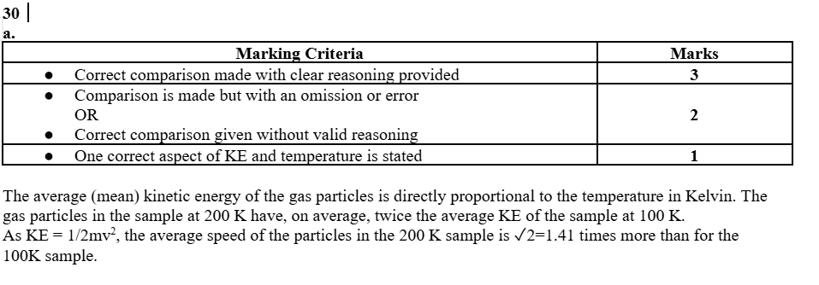
Marking Rubric
Use your faculty ones
Be specific
Clearly allocate marks
Does well with a table format
Notes:
Marking rubric
Often already exists, if not - can use AI to help get the bare bones
Very specific- include examples of correct and incorrect responses.
Be clear about mark allocation- stipulate about half marks
Seems to favour the table format

Slide 7
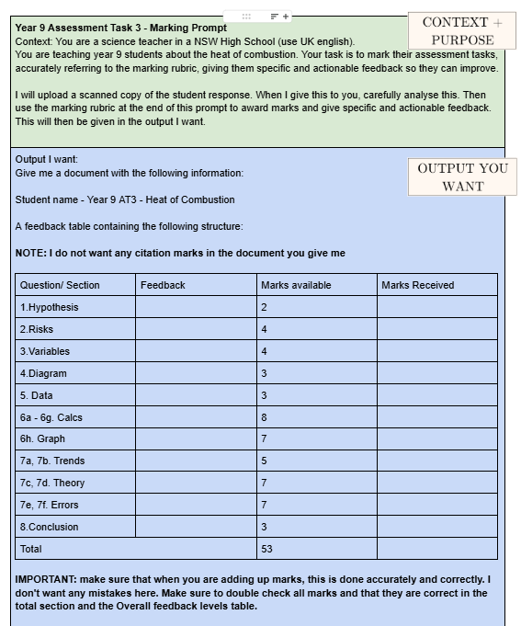
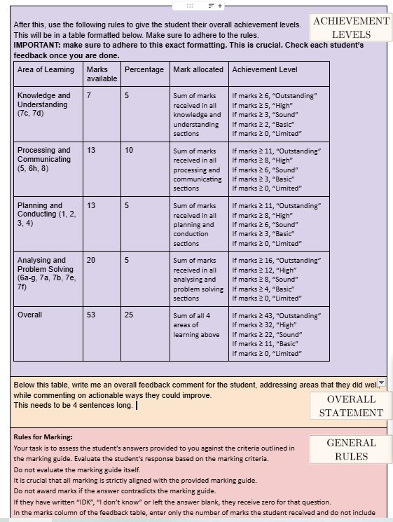
Prompt Engineering
What is a prompt?
Why use a document?

Slide 8
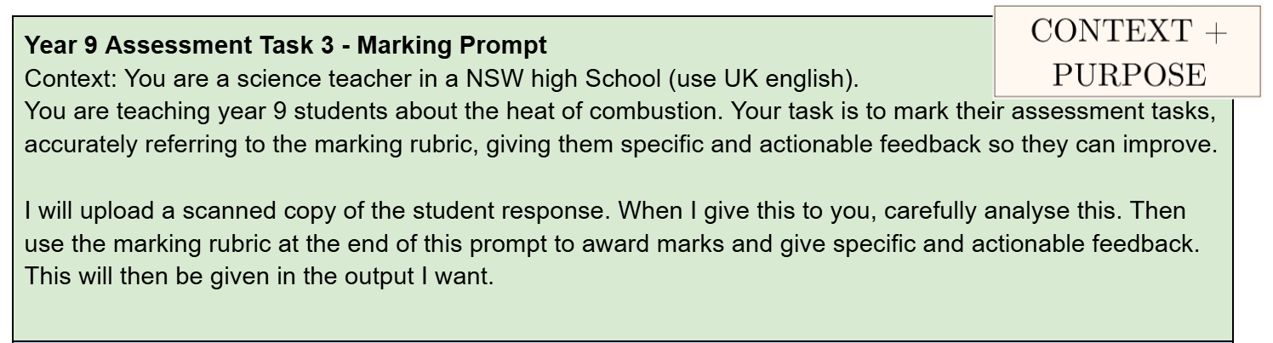
Prompt Engineering
Context and Purpose
School teacher in Australia
specific and actionable feedback
both constructive and encouraging

Slide 9
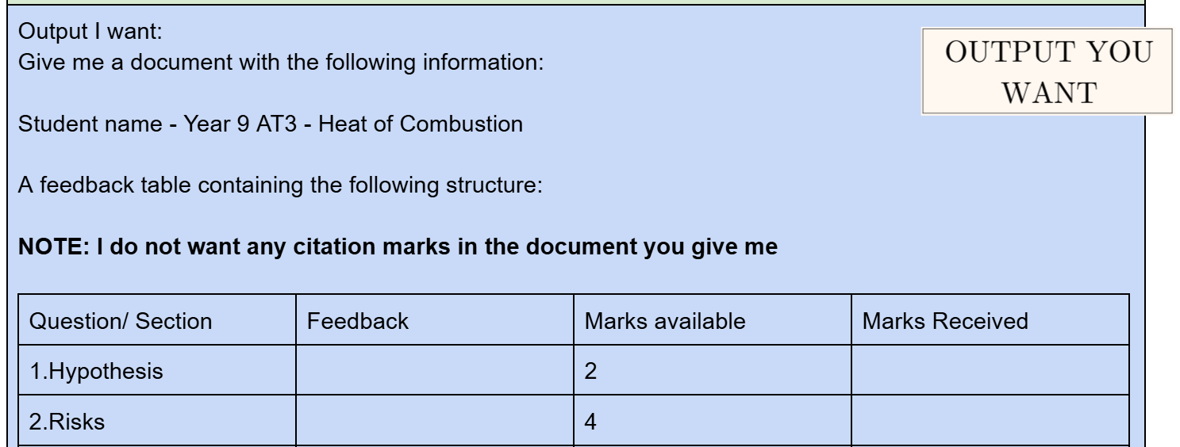
Prompt Engineering
Getting the right output

Slide 10
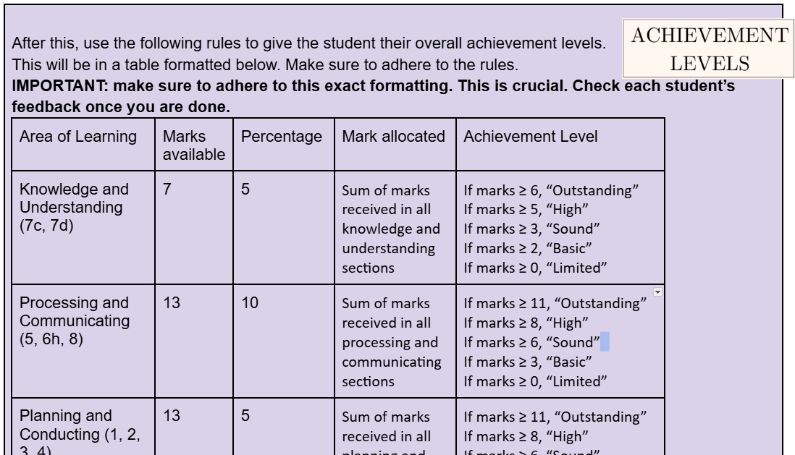
Prompt Engineering
Overall achievement summary

Slide 11
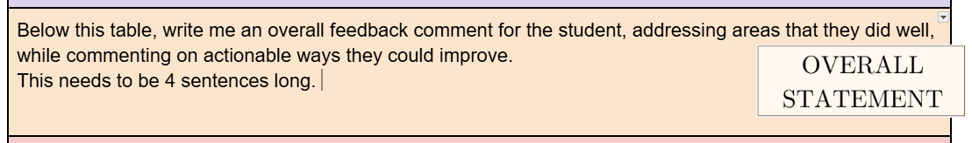
Prompt Engineering
Overall statement

Slide 12

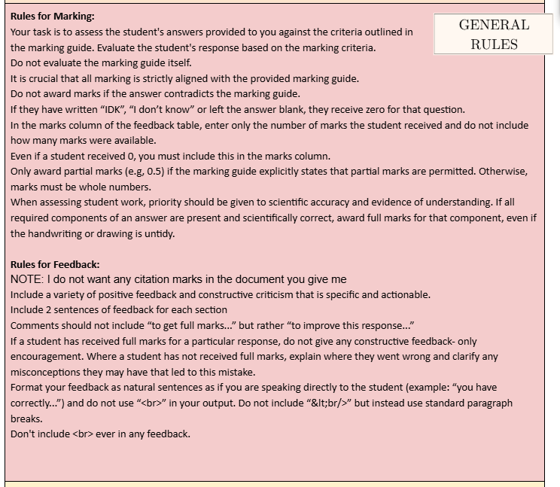
Prompt Engineering
The 14 commandments for Marking and Feedback
Notes:
Copy these from the template, but there’s a story behind each which I won’t go into now.
7 Commandments for marking:
Only evaluate based on marking criteria
Do not award marks if the answer contradicts the marking guide
If they write I don’t know, idk or leave blank- incorrect
Enter only a number in the marks column
Only award half marks if stated by marking guide
even if a student receives 0, still record marks
Do not deduct marks for untidy handwriting if it is correct
7 Commandments for feedback:
Variety of constructive and positive feedback- no more than 2 sentences per question.
If they receive full marks, only encourage them
When not full marks, clarify misconceptions
Format as natural sentences as if speaking to the student
Don’t say “to get full marks” but rather “to improve”
No citation marks
Never include <br> in any feedback

Slide 13

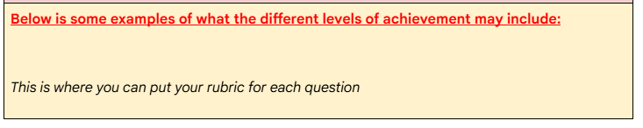
Prompt Engineering
Marking rubric

Slide 14
Notes:
This is my deidentified student sample. You can use student numbers if you like.
See the highly structured task design.
Upload to new chat with the 2.5 Pro model. Takes longer but worth it for the reasoning and math capabilities.
Took 94 seconds to do 3 tasks like this. It takes about 4-5 minutes to handle 10 at a time. I have batch processed a year group of 80 papers in less than an hour- not including formatting and checking.
Notice the output is consistent with our instructions. Section, feedback, marks, then the overall comment and the overall achievement.
We export to Google docs, then tidy it up so that it prints nicely double sided (go for 2 or 4 pages).

Slide 15

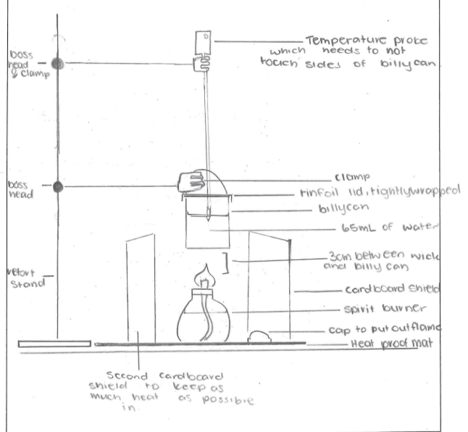
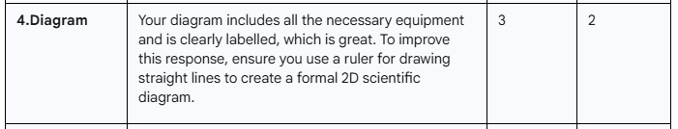
The need for vigilance!
Notes:
Feedback for the diagram looks great…. Until you see the diagram is perfectly ruled. Watch those diagram questions.

Slide 16

Reviewing whole class results
AI-assisted reflective practice

Slide 17
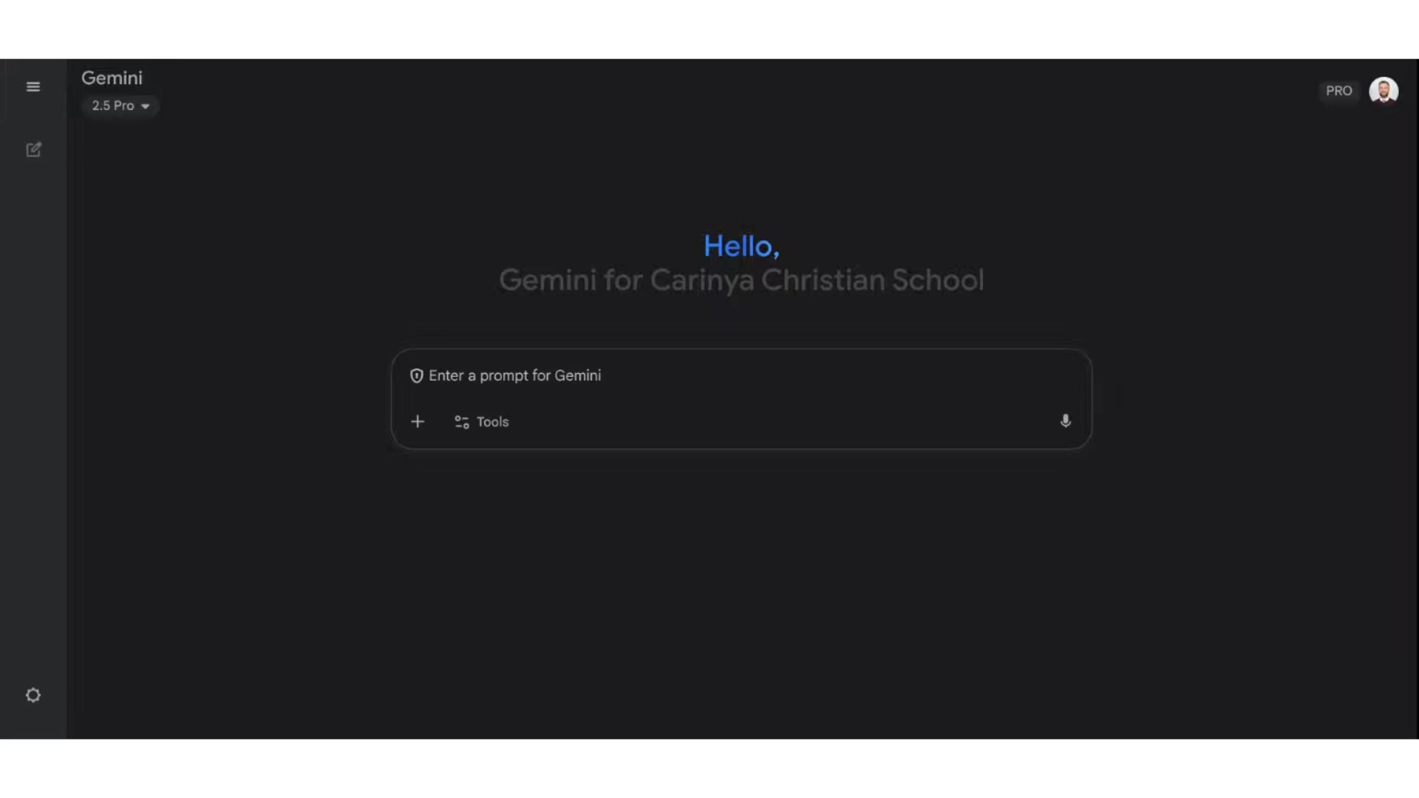
Notes:
Reviewing class results- generating summaries
Start by running an analysis on your full feedback document.
Key Strengths- calculations- good!
Areas for development- Using data in analysis was something I also picked up.
Recommendations for Future instruction
Use it to group students based on what they did well or need to improve so that you can differentiate or identify some key peer leaders in those follow up lessons.
Vast data→ informed teaching practice
This is a breakthrough for me. Makes this part really fun because you’re prompting to gain insights about your class! Just fascinating and really helpful.

Slide 18

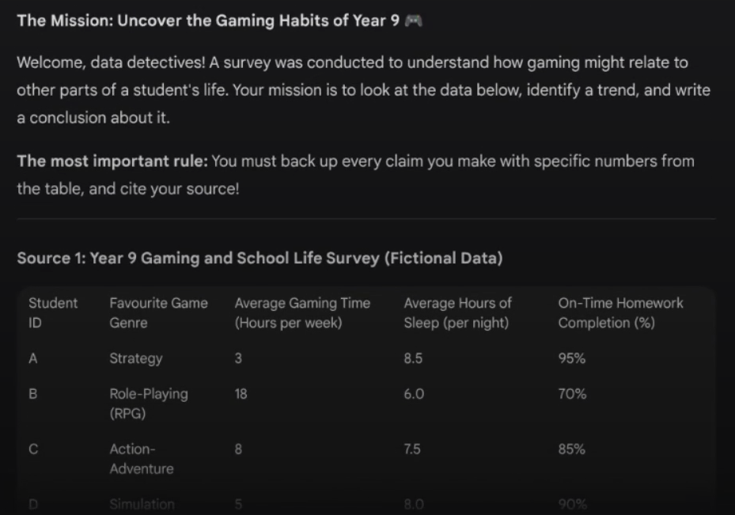
Notes:
Cut if short on time:
Follow up questions can help you design the remedial activities since it has all that context already. Engaging dataset to practice citing numbers in conclusions. We often move at such a pace with our content, that we don’t have the luxury of slowing down to spend a remedial lesson after a task- so get AI to integrate these remedial activities into your next topic!

Slide 19

Alternative Applications of AI in Assessment
Hybrid model
Voice typing
Reflecting at scale
Notes:
Alternative methods (2 mins)
Hybrid- Manual mark diagrams/graphs and AI mark the rest
Voice type and then refine
Teacher reflection at scale (80+ papers)

Slide 20

Have a play with it!
Teaching is not a desk job- it’s a people job.
Notes:
Have a play with it!
Have a go. Copy these prompts- I have sent the sample prompts to HunterWiSE to distribute.
Best case scenario is that we can improve outcomes for students AND cut down teachers’ administrative loads, then it’s worth it.
It’s a very exciting time to be teaching because we now have a technology that is letting us go back to the days where teaching is not a desk job- it’s a people job. And that- is what I signed up for. That’s what I want to do for the next 20 years.

Slide 21

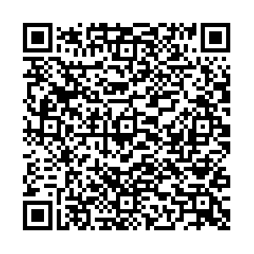

Notes:
If you found this helpful, I’ve put together a free PD course called Gemini from the Groundfloor. There’s some video tutorials with pdfs that you can use to get started in using Gemini for the most arduous teacher admin tasks like risk assessments, report writing, marking and feedback and so on. You can google the title or scan the QR code or find it through the science and engineering challenge website.

